Slide 1

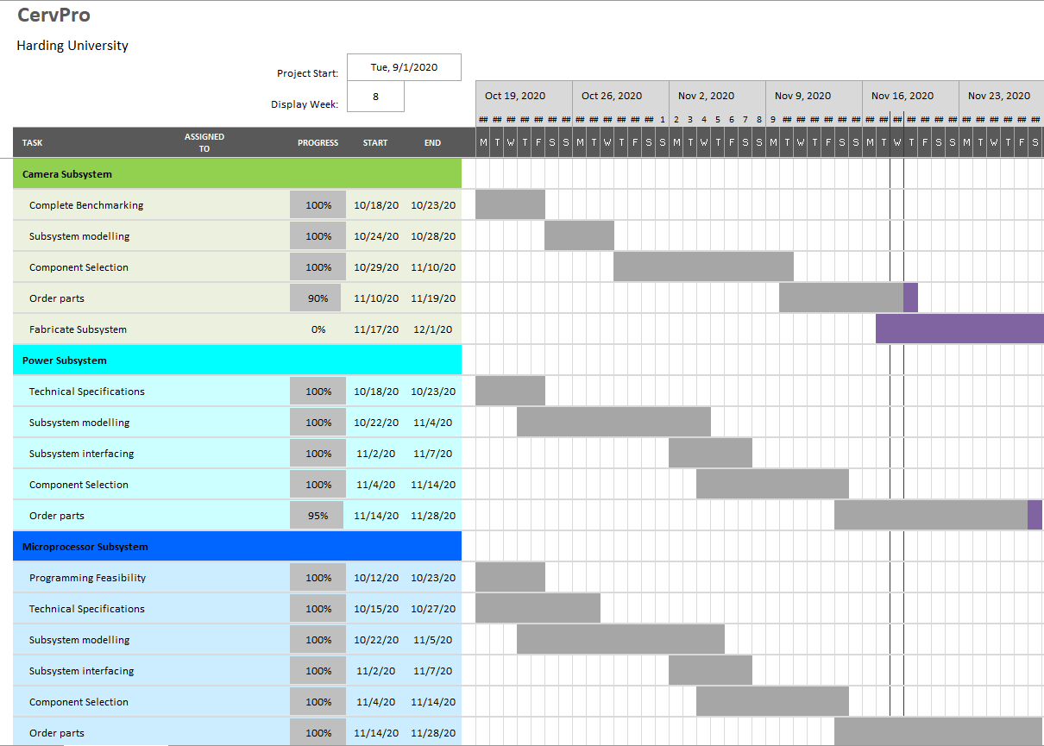

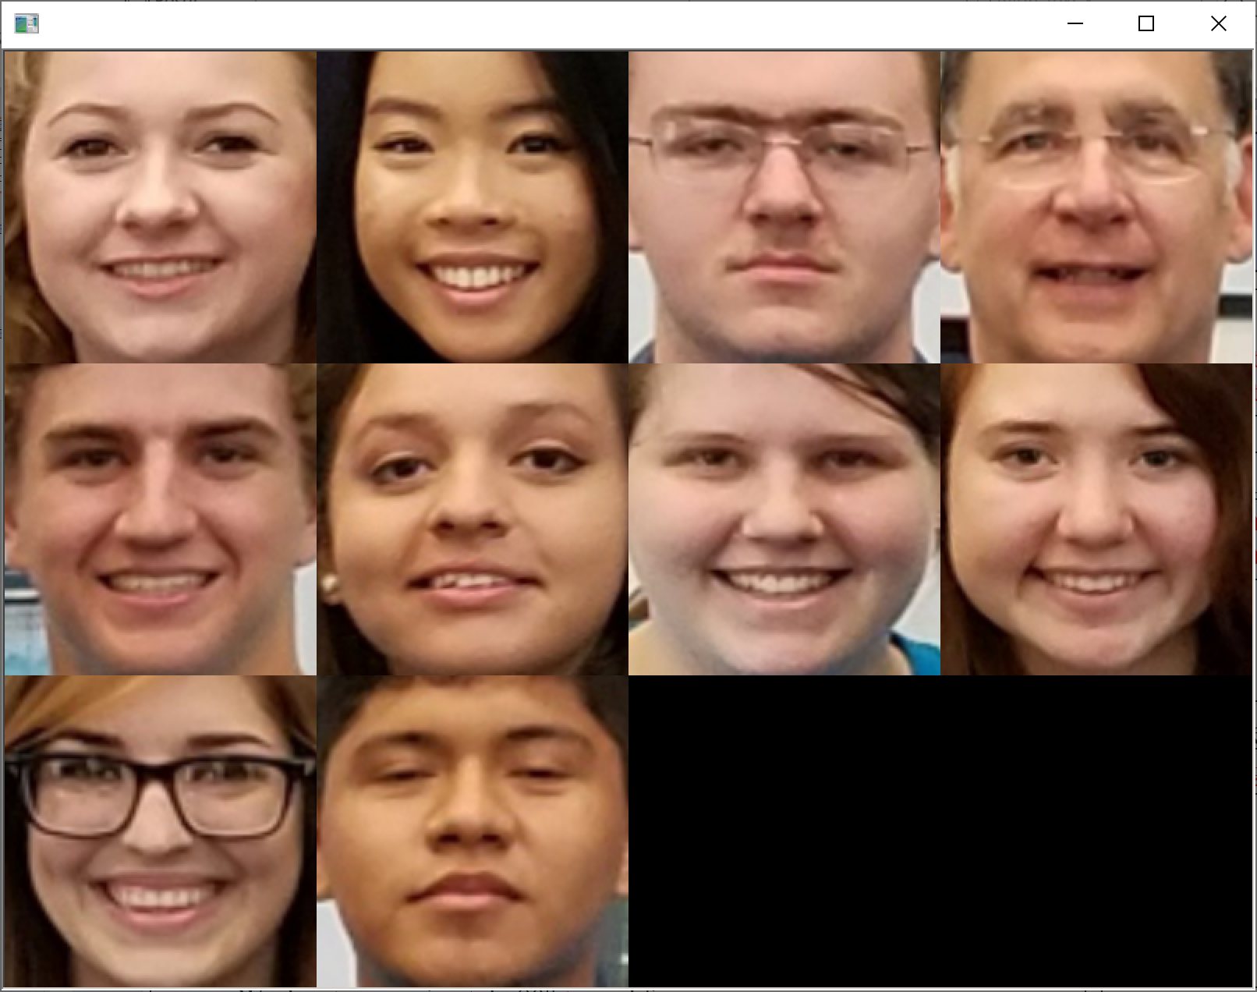
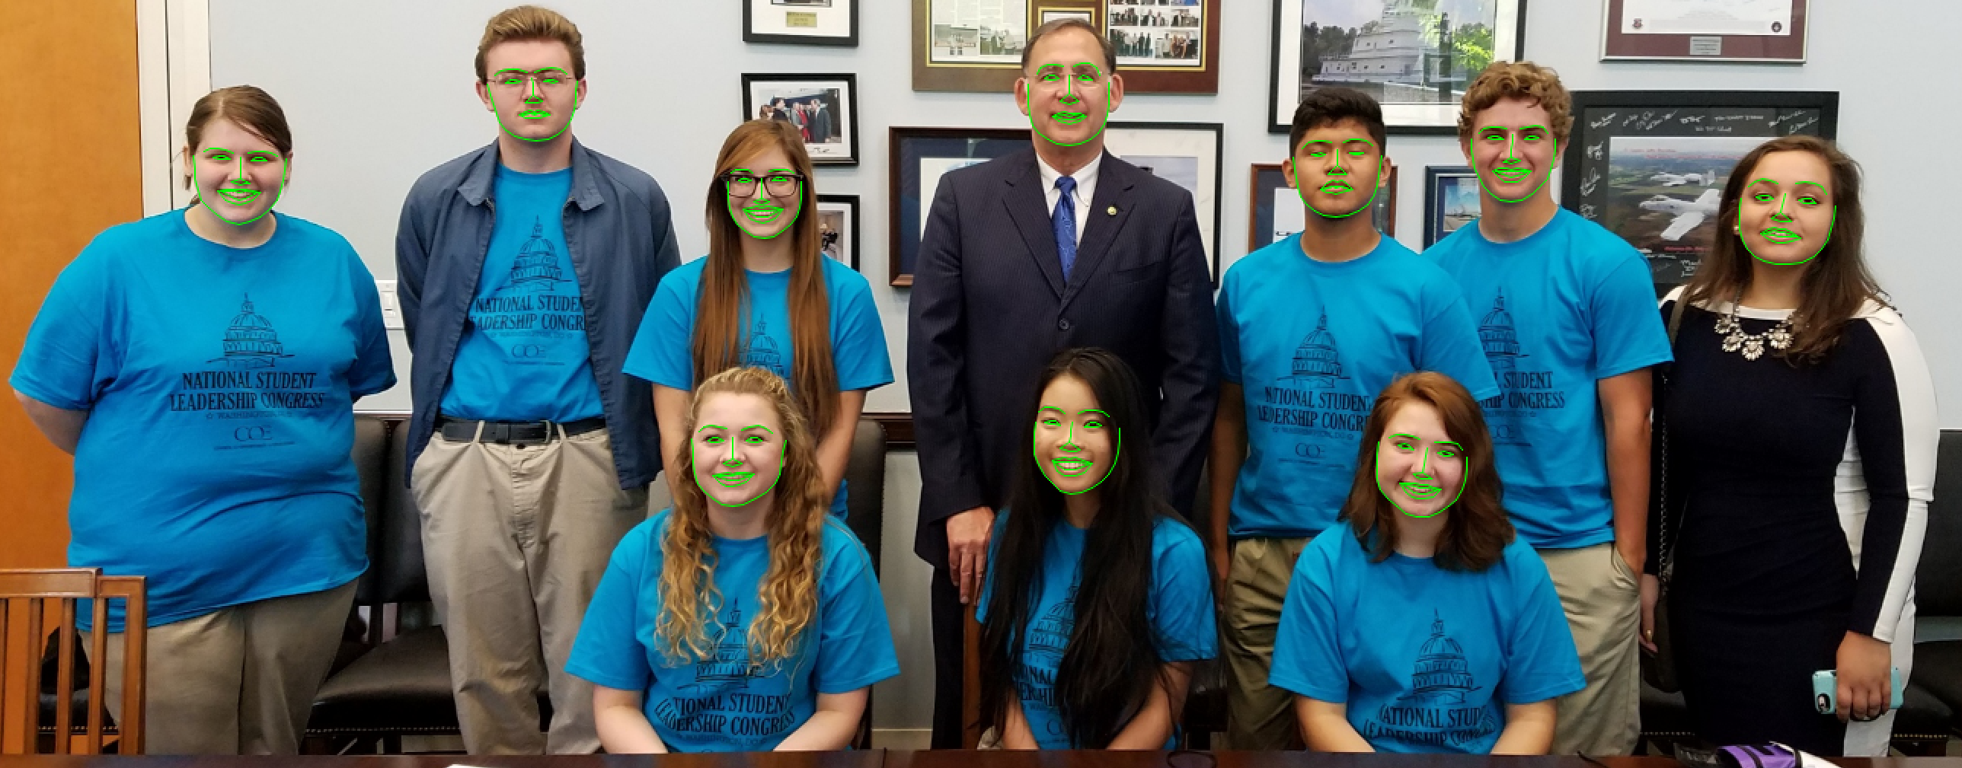
CervPro
Cervical Proprioception Diagnosis: A3 Status
Date: November 19, 2020
Members: Nathan Vielmette, Ethan Grimes, Keneth Chelelgo, and George Cook
Background
PT cervical proprioception (CP) assessments are subjective and determined by PT opinion.
Motivation is to create device that gives PTs objective data that shows patients’ ability to sense head and neck position in space.
Device will sense head position and angular velocity.
Analysis
Does it work at up to 80° turned faces?
Does it process fast enough?
Proposed Countermeasures
Run the program with faces at different angles.
Run the program multiple times and time it.
Current Conditions
Recent Results
Facial recognition is now running
Image processing is now running
Parts ordered
Goals/Targets
Main MPU power draw of 10W (5V, 2A)
Bluetooth MPU power draw of 5W (5V, 1A)
Processes at 60 frames per second
- 1.4 GHz
- 6 Gbps
Works at approximately 80° turned faces
3 USB ports
Next Steps
Integrating OpenCV and dlib programs.
Test if the current facial recognition algorithm is accurate.
Test if the current facial recognition algorithm is fast enough.
Begin learning mobile development.

